Slide 1
Senior design – Week 8
Leader: Zane Saul
Emmanuel Anih
Clare Collins
Victor Hernandez
AJ Krawczyk
Matthew Morey
Spencer Roberts

Slide 2
Parts are coming in
Total Cost of Project thus far
Parts received list
2 out of 3 Stepper motors
Boeray 20 Sets Aluminum Profile 2020 Series
100Pcs M5 x 1mm Stainless Steel Metric Flat Washer
CNC, Power Converter, 52mm Clamp set (1)
Metric M5x0.8mm Nuts (2)
T-Screw Bolt Pack 25 (2)
Driver (1)
$696.94

Slide 3
Parts not recieved
Stepper motor (1)
Rasberry PI (1)
5.0 MP Camera (1)
Dual Rail Guide Support (3)
5 Hole 90° Joining Plate (2)
T-Slotted Extrusion Bar (2)
Drivers (2)
T-Slotted Extrusion Plate (1)

Slide 4
Everyone's update
AJ is feeling better
Will give Claire dimensions for aluminum brick
Claire is coordinating with Mr. Collins on getting an aluminum brick
Mathew has auto cad drawings
Victor has drawing of part for X/Z axis intersect ( to be included in next weeks presentation )
Spencer has completed ( to be included in next weeks presentation )
House of Quality
Customer Needs form
Started a few other forms

Slide 5
Timeline (Somewhat on track)
Sep. 28: Parts List Due ( Turned in Oct 12 )
Oct. 26: Frame Assembled
Nov. 16: X/Y/Z Axis Complete
Dec. 3: Motors Complete
Dec. 7: Alexa Software Compatibility
Dec. 8: Final Completion Date

Slide 6
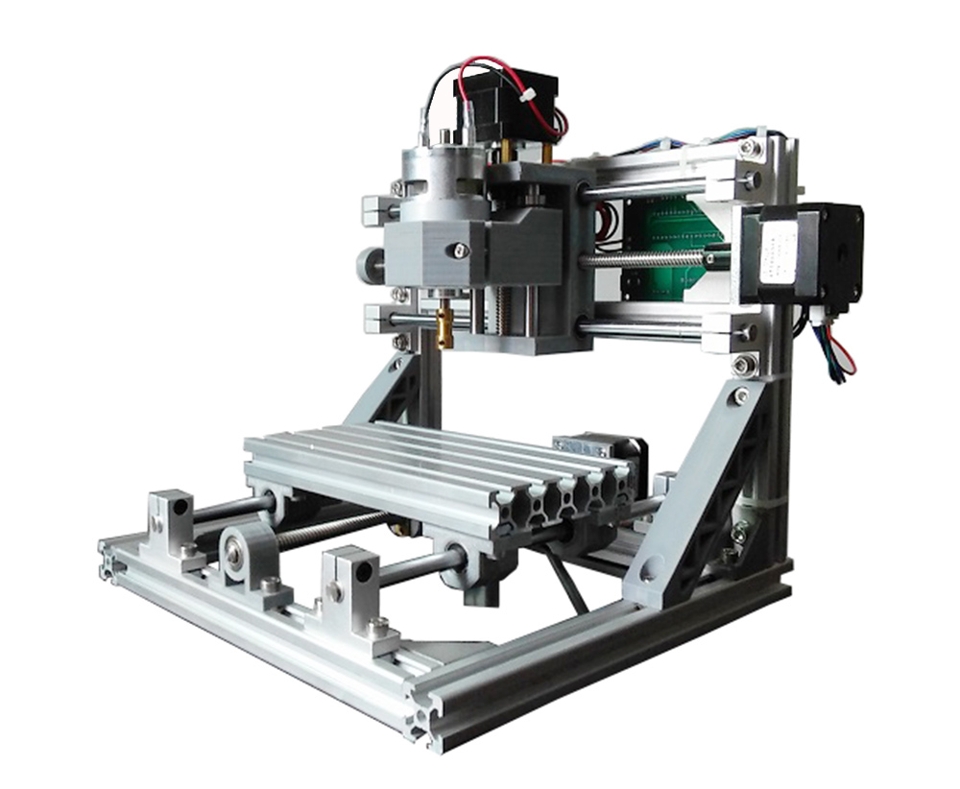

Slide 7
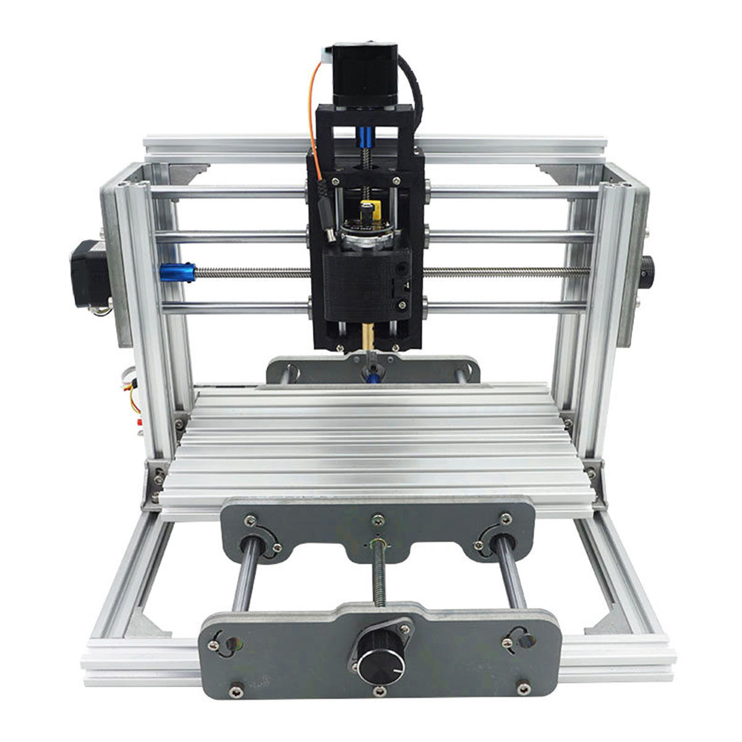

Slide 8
